Slide 1
COMP 2000
Week 13 - Monday

Slide 2
Last time
What did we talk about last time?
Sorting
Arrays.sort()
Collections.sort()
Comparable<T> interface
Custom Comparator<T> objects

Slide 3
Questions?

Slide 4
Project 4

Slide 5
Software Engineering

Slide 6
A few things we want from software engineering
Characteristic | Description
Maintainability | We can update the code to add in new requirements and features.
Dependability and security | Software is reliable, secure, and safe. Systems failures don't cause physical or economic damage. Hackers can't break in or damage the system.
Efficiency | Software uses processors and memory efficiently. Software is responsive.
Acceptability | The users of the software can understand and use the software, and it's compatible with other tools they use.

Slide 7
Why software engineering is important
People need software
  It's everywhere, in every facet of life
  If it doesn't work correctly or is vulnerable to attack, people can be hurt, die, suffer financial losses, etc.
It's cheaper to engineer it the right way
  Hacking stuff together seems faster and cheaper…at first
  But for large, long term projects, a well-managed development process ends up saving money and time

Slide 8
Waterfall model
Requirements Definition
System and Software Design
Implementation and Unit Testing
Integration and System Testing
Operation and Maintenance
In theory, these stages are separate
In practice, they often feedback to each other
It's very expensive if mistakes are discovered in later stages
  One rule of thumb is that mistakes costs 10 times as much to fix than they would have at a previous stage

Slide 9
Incremental development
Incremental software development starts with an initial version that evolves with user feedback
Specification, development, and validation happen continually and concurrently
Incremental development is a cornerstone of Agile development
Specification
Initial Version
Outline Description
Development
Intermediate Versions
Validation
Final Version

Slide 10
Pros and cons of incremental development
Pros
Cons
The cost of changing customer requirements is smaller
It's easier to get customer feedback
Rapid delivery and deployment of usable software is possible
There's less documentation since it's time-prohibitive to document each rapidly changing version
Structure tends to worsen over time as more code is added
  Time must be spent on refactoring

Slide 11
UML

Slide 12
Modeling
At both the requirements stage and the design stage, modeling can be useful
Modeling mostly means drawing boxes and arrows
We want high-level descriptions of:
  What the thing is supposed to do
  What parts it's composed of
  How it does what it does

Slide 13
System modeling
Models leave out details
Models are useful to help understand a complex system
  During requirements engineering, models clarify what an existing system does
  Or models could be used to plan out a new system
Models can represent different perspectives of a system:
  External: the context of a system
  Interaction: the interactions within the system or between it and the outside
  Structural: organization of a system
  Behavior: how the system responds to events

Slide 14
UML
The Unified Modeling Language (UML) is an international standard for graphical models of software systems
A few useful kinds of diagrams:
  Activity diagrams
  Use case diagrams
  Sequence diagrams
  State diagrams
Class diagrams are important enough that we'll talk about them in greater detail

Slide 15
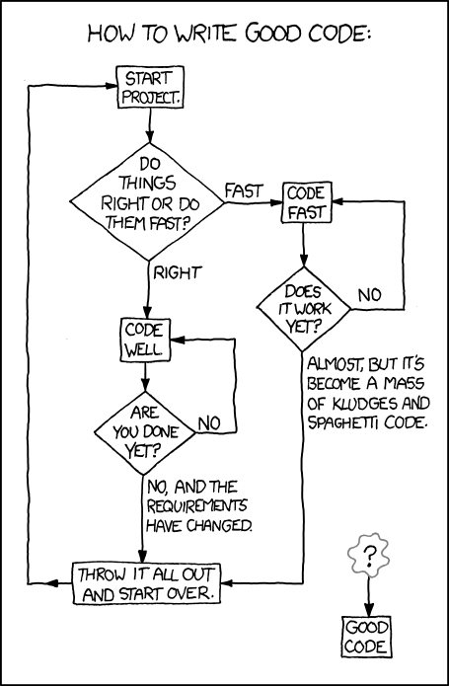
Activity diagrams
Activity diagrams show the workflow of actions that a system takes
XKCD of an activity diagram for writing good code
  From: https://xkcd.com/844/
Formally:
  Rounded rectangles represent actions
  Diamonds represent decisions
  Bars represent starting or ending concurrent activities
  A black circle represents the start
  An encircled black circle represents the end

Slide 16
More detailed activity model

Slide 17
Data-driven modeling
Data-driven models show how input data is processed to generate output data
The following is an activity diagram that shows how blood sugar data is processed by a system to deliver the right amount of insulin

Slide 18
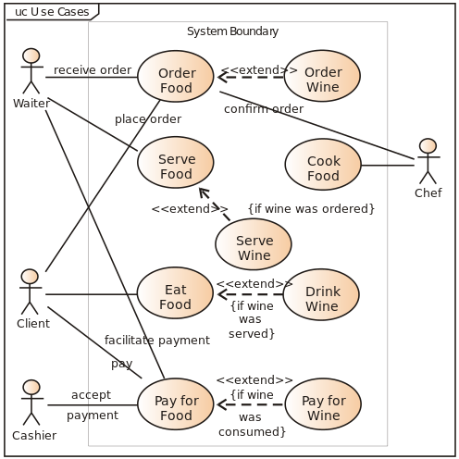
Use case diagrams
Use case diagrams show relationships between users of a system and different use cases where the user is involved
Example from Wikipedia:

Slide 19
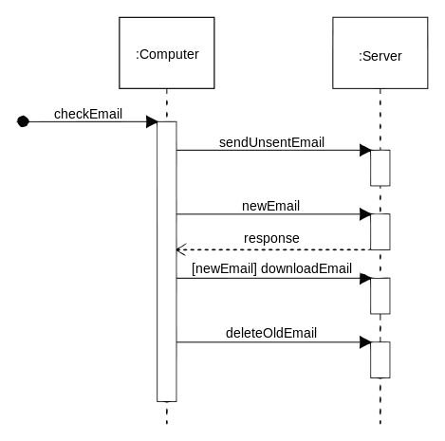
Sequence diagrams
Sequence diagrams show system object interactions over time
These messages are visualized as arrows
  Solid arrow heads are synchronous messages
  Open arrow heads are asynchronous messages
  Dashed lines represent replies
Example from Wikipedia:

Slide 20
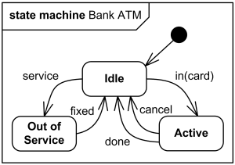
State diagrams
State diagrams are the UML generalization of finite state automata from discrete math
They describe a series of states that a system can be in and how transitions between those states happen
Example from uml-diagrams.org:

Slide 21
Event-driven modeling
Event-driven modeling is another kind of behavioral modeling that focuses on how a system responds to events rather than on processing a stream of data
Here's a state diagram for a microwave oven based on various outside events

Slide 22
Class Diagrams

Slide 23
Structural models
Structural models show how a system is organized in terms of its components and their relationships
UML class diagrams are used for structural models, but they can be used in many different ways:
  Relationships
  Generalization
  Aggregation

Slide 24
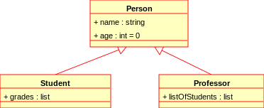
Class diagrams
Class diagrams show many kinds of relationships
The classes being described often (but not always) map to classes in object-oriented languages
The following symbols are used to mark class members:
  + Public
  - Private
  # Protected
  / Derived
  ~ Package
  * Random
Example from Wikipedia:

Slide 25
Relationships
Associations between classes can be drawn with a line in a class diagram
Notations can be used to mark relationships as one to one, many to one, many to many, etc.
These kinds of relationships are particularly important when designing a database

Slide 26
Generalization
Classes can be listed with their attributes
However, there are often classes that share attributes with each other
Some classes are specialized versions of other classes, with more attributes and abilities
This relationship between general classes and more specialized classes is handled in Java by the mechanic of inheritance

Slide 27
Aggregation
Another way of using class diagrams is to show that some objects or classes are made up of smaller parts represented by other classes
A diamond shape is used to mark a class that is the whole, and its parts are connected to the diamond

Slide 28
Architectural Design

Slide 29
Architecture
Architecture describes the main structural components in a system and the relationships between them
Architectural design is somewhat freeform
  It's hard to follow a recipe for architectural design
There's overlap between requirements engineering and architectural design
Block diagrams are commonly used to describe architecture:

Slide 30
Advantages of well-documented architecture
Stakeholder communication
  Everyone involved in the project can understand the system at a high level
System analysis
  Creating architecture requires some (hopefully useful) analysis
Large-scale reuse
  Architecture describes how a system is organized and how the components interoperate
  Since system architectures are similar for systems with similar requirements, it may be possible to choose an off-the-shelf system with the right architecture

Slide 31
Architectural design decisions
Since architecture is somewhat free-form, a good way to guide the design is by asking questions
Since non-functional requirements often relate to the system as a whole, which non-functional requirements should the architecture focus on?
  Performance
  Security
  Safety
  Availability
  Maintainability
Emphasis on one area may hurt other areas
  For example, greater security usually comes at the cost of performance

Slide 32
Architectural Patterns

Slide 33
Architectural patterns
Even though architectural design is somewhat free-form, architectural patterns have evolved that fit many different kinds of programs
An architectural pattern is an abstract description of a system that has worked well in the past
Examples:
  Model-view-controller
  Layered architecture
  Repository architecture
  Client-server architecture
  Pipe and filter architecture

Slide 34
Model-View-Controller
The Model-View-Controller (MVC) pattern fits many kinds of web or GUI interactions
The model contains the data that is being represented, often in a database
The view is how the data is displayed
The controller is code that updates the model and selects which view to use
The Java Swing GUI system is built around MVC
Good: greater independence between data and how it's represented
Bad: additional complexity for simple models

Slide 35
Layered architecture
Organize the system into layers
Each layer provides services to layers above it, with the lowest layer being the most fundamental operations
Layered architectures work well when adding functionality on top of existing systems
Good: entire layers can be replaced as long as the interfaces are the same
Bad: it's hard to cleanly separate layers, and performance sometimes suffers

Slide 36
Repository architecture
If many components share a lot of data, a Repository pattern might be appropriate
Components interact by updating the repository
This pattern is ideal when there is a lot of data stored for a long time
Good: components can be independent
Bad: the repository is a single point of failure

Slide 37
Client-server architecture
Client-Server patterns are used for distributed systems
Each server provides a separate service, and clients access those services
Good: work is distributed, and clients can access just what they need
Bad: each service is a single point of failure, and performance might be unpredictable

Slide 38
Pipe and filter architecture
In the Pipe and Filter pattern, data is passed from one component to the next
Each component transforms input into output
Good: easy to understand, matches business applications, and allows for component reuse
Bad: each component has to agree on formatting with its inputs and outputs

Slide 39
Upcoming

Slide 40
Next time…
Testing
Introduction to JUnit

Slide 41
Reminders
Work on Project 4
Lab is tomorrow

